Slide 1

Forecasting waved daily covid-19 death count series with a novel combination of segmented Poisson model and ARIMA models
Journal of Applied Statistics, 2023
Zhang, Xiaolei & Ma Renjun
JOURNAL OF APPLIED STATISTICS 2023, VOL. 50, NOS. 11–12, 2561–2574 https://doi.org/10.1080/02664763.2021.1976119
By Armin Mahdavi 31 July 2025

Slide 2
Introduction
Article’s key focus was 2020 COVID-19 deaths for USA and Canada
Proposes to employ two different models, for various reasons.
Segmented Poisson model, to “capture mean structures of data in waves” and to respect count aspect of data.
And, ARIMA model, commonly used for infectious diseases
Proposes combining both model types in two-stage approach

Slide 3
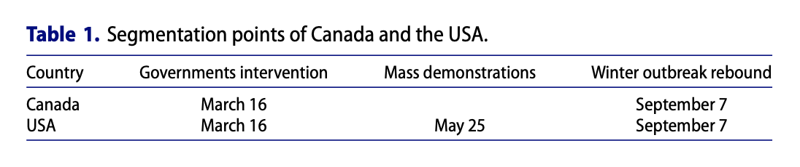
Data Collection, Key Features
Data will need to consider key policy and govt intervention dates

Slide 4
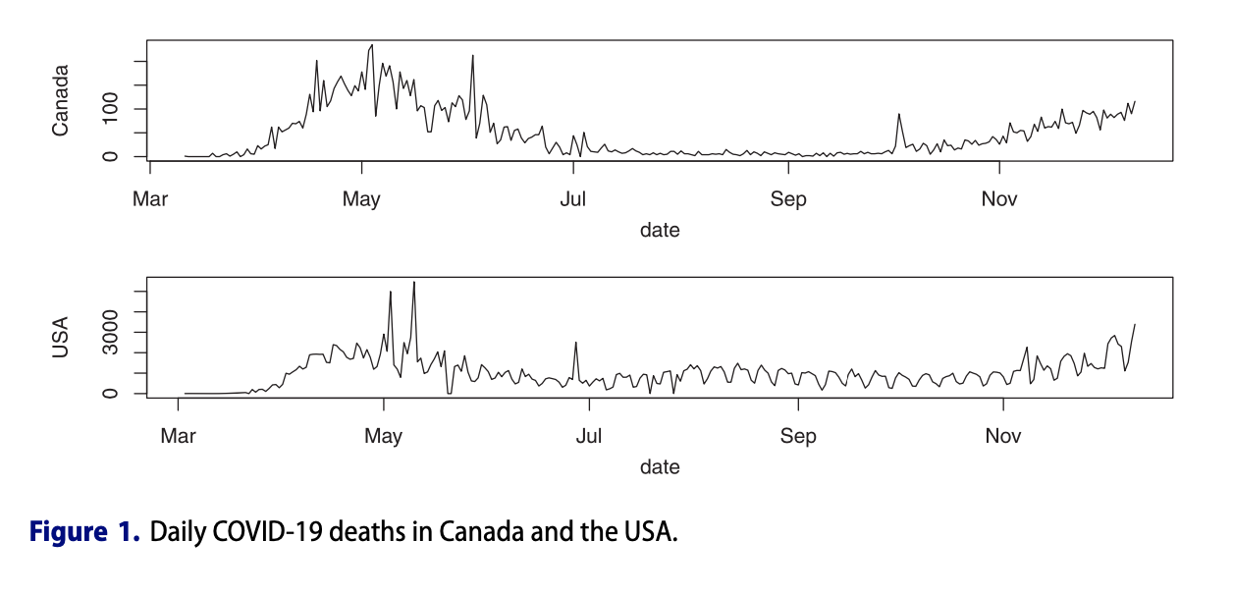
Data Collection, Key Features
Cyclical seasonal nature of data for the year -> time series
Unequal wavelengths of the data, time-varying variances
Typical regression modeling for this global mean structure unlikely to fit appropriately.

Slide 5
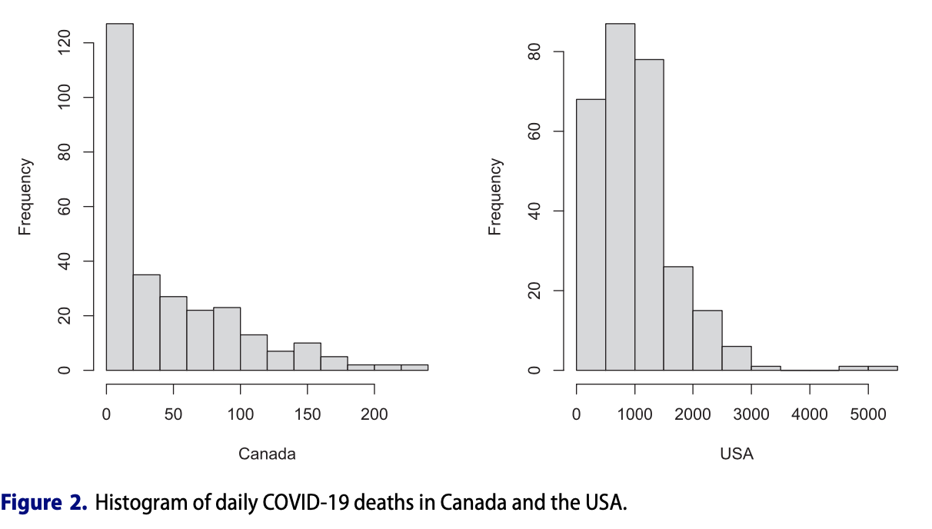
Data Collection, Key Features
Very skewed data
Some zero counts + High proportion of low counts
Methods that assume approximate normality would not be appropriate

Slide 6
Statistical Methods
How to resolve the three key features?
Segment the data based on those important policy dates, then focus on each chunk of data.
Apply Poisson regression to detrend the data by removing overall mean structure/trend
Captures piecewise trends in data
Detrended data’s raw residuals can then be used and modeled by ARIMA

Slide 7
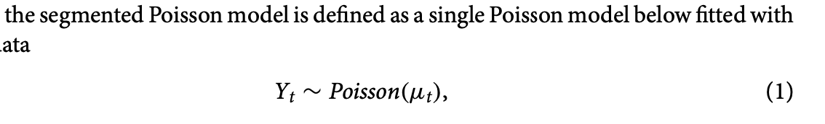
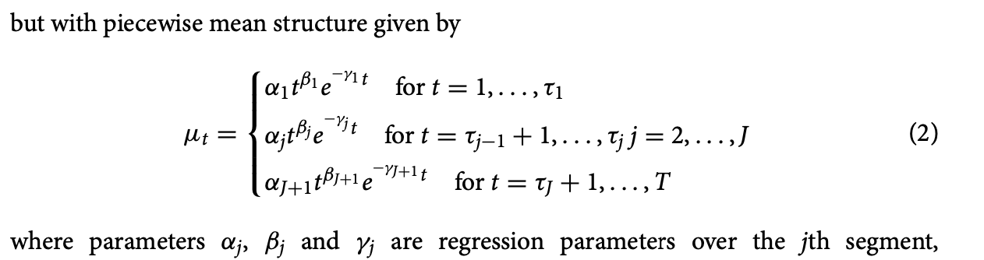
Segmented Poisson Model
Tau1 = 1 week or 7 days after starting data of major government intervention.

Slide 8
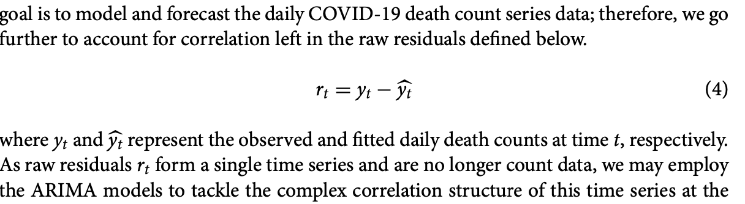
ARIMA Model
ARIMA modeling assumes stationarity, key assumption
(mean and variance shouldn’t change over time)

Slide 9
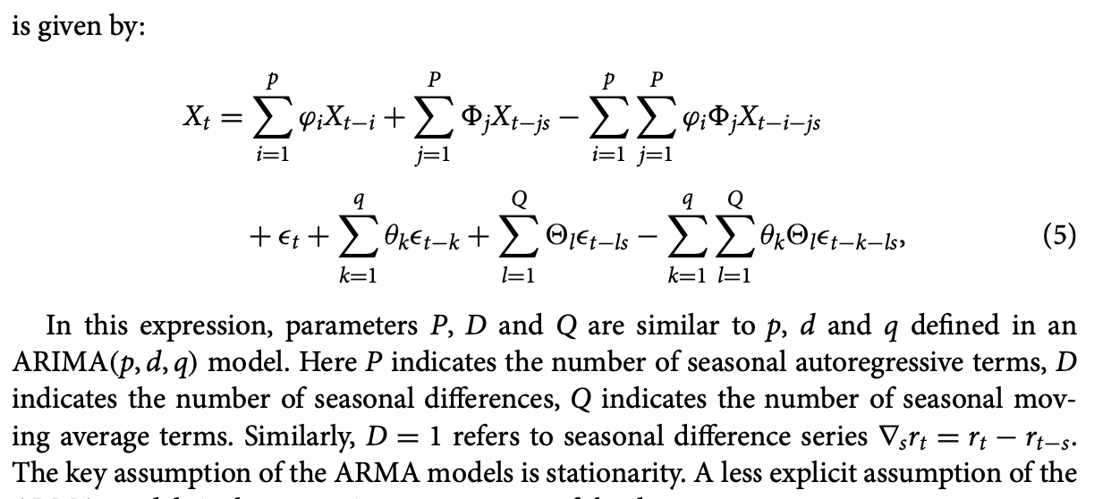




ARIMA Model
Regular AR
Seasonal AR
Seasonal MA
Regular MA

Slide 10
Limitations and Considerations
Must manually segment data based on segmentation points in order to set it up for modeling.
Policy dates, like in Table 1
Requires stationarity and approximate symmetry for ARIMA
Segmented Poisson modeling needs a specific function form, the power-exponential trend
Won’t adapt to new structural changes, govt interventions, new COVID waves

Slide 11
Conclusion
Improve segmentation from manual to automation
This two-stage approach can be adapted to ”model and forecast development of other infectious diseases as well.”
Their novel approach captured wave-based COVID-19 daily death data with good forecasting power, by their own account

